Slide 1
FINDING MINIMAL FEATURE SET FOR DEPRESSION DATA WITH MRMR AND SVM
Venkatesham Chintapandu
Vaishnavi Mahipathi

Slide 2

MOTIVATION
Depression is a psychological disorder that is difficult to diagnose.
Statistics say that about 9 percent of American adults from all walks of life suffer from some form of depression.
A few Statistics:
Anxiety disorders are the most common mental illness in the U.S., affecting 40 million adults in the United States age 18 and older (18% of U.S. population).
At any point in time, 3 to 5 percent of people suffer from major depression; the lifetime risk is about 17 percent.

Slide 3
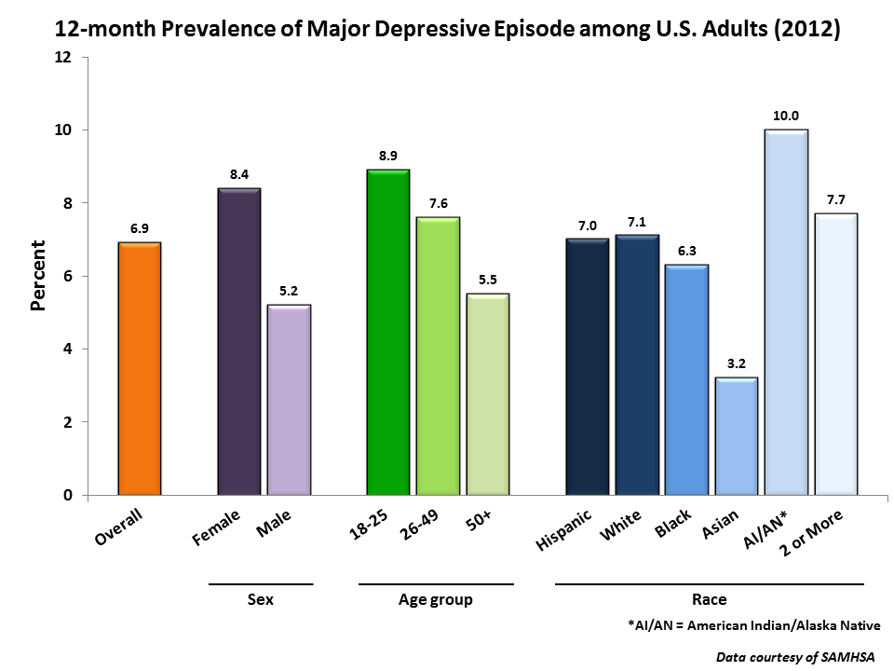
According to the NIMH, depression affects:
More than 40 percent of those with post-traumatic stress disorder
25 percent of those who have cancer
27 percent of those with substance abuse problems
50 percent of those with Parkinson's disease
50 to 75 percent of those who have an eating disorder
33 percent of those who've had a heart attack

Slide 4
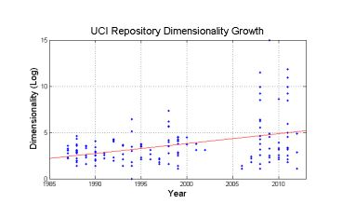
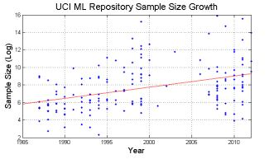
INTRODUCTION
The growth of the high-throughput technologies has resulted in exponential growth in the harvested data with respect to both dimensionality and sample size.
These collected data is usually associated with a high level of noise.

Slide 5
DATA REDUCTION
Curse of Dimensionality
When dimensionality increases, data becomes increasingly sparse
The possible combinations of subspaces will grow exponentially
Dimensionality Reduction
Eliminate irrelevant features
Reduce noise
Reduce time and space required in data mining
Allow easier visualization
Dimensionality Reduction techniques:
Principal Component Analysis (PCA)
Supervised and non linear techniques(Ex: Feature Selection, Feature Extraction, etc.)

Slide 6
FEATURE SELECTION
Feature selection or data dimension reduction or variable screening in predictive analytics refers to the process of identifying the few most important variables or parameters which help in predicting the outcome
It includes the process of selecting a subset of the terms occurring in the training set and using only this subset as features in classification.
Why Feature Selection?
The law of averages states that the larger the set of predictors, the higher the probability of having missing values in the data. If we chose to delete cases which have missing values for some predictors, we may end up with a shortage of samples.
Why Feature selection over Feature Extraction?
Feature selection is superior in terms of better readability and interpretability since it maintains the original feature values in the reduced space while feature extraction transforms the data from the original space into a new space .

Slide 7
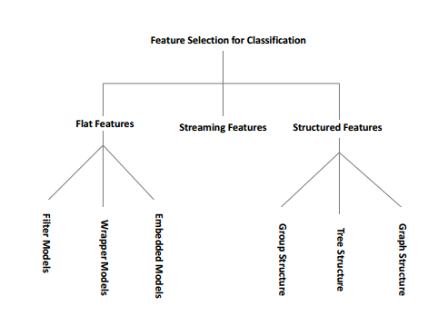
Supervised feature selection methods can further be broadly categorized into filter models, wrapper models and hybrid models.

Slide 8
RELATED WORK
Boosting with Feature Selection Technique for Screening and Predicting Adolescents Depression by Putthiporn Thanathamathee School of informatics, Walailak University
Describes a model that uses adolescents depression data for screening and testing.
Uses filter model for screening and predicting
Selection Techniques Used : Max Relevance Min-Redundancy (MRMR)
Learning Classifier: Decision tree
Original feature set : 20
Feature set after Selection : 12

Slide 9
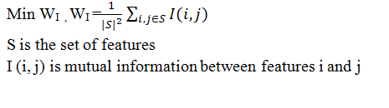
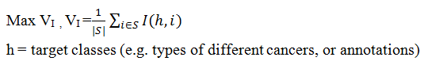
MRMR TECHNIQUE
Minimize Redundancy:
Maximize Relevance:

Slide 10
PROPOSED IMPLEMENTATION
The new idea proposed in this project is to use a hybrid model.
Step 1: searching a subset of features with MRMR Technique
Step 2: evaluating the selected subset of features by the performance of the learning Classifier SVM
Step 3: repeating Step 1 and Step 2 until the desired quality is reached.

Slide 11
What is SVM?
Support vector machines (SVMs) are supervised learning models with associated learning algorithms that analyze data and recognize patterns, used for classification.
An SVM model is a representation of the examples as points in space, mapped so that the examples of the separate categories are divided by a clear gap that is as wide as possible. New examples are then mapped into that same space and predicted to belong to a category based on which side of the gap they fall on.

Slide 12
Why SVM over other classifiers?
SVM can model complex, real-world problems such as text and image classification, hand-writing recognition, and bioinformatics and bio-sequence analysis.
SVMs deliver a unique solution. This is an advantage compared to Neural Networks, which have multiple solutions associated with local minima and for this reason may not be robust over different samples
SVM performs well on data sets that have many attributes, even if there are very few cases on which to train the model. Traditional neural nets do not perform well under these circumstances.
It is a useful classifier when the data are not regularly distributed or have an unknown distribution

Slide 13
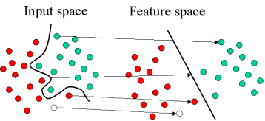
Support vector machine constructs a hyper plane or set of hyper planes in a high- or infinite-dimensional space, which can be used for classification, regression, or other tasks

Slide 14
WHY MRMR WITH SVM?
MRMR is a filter model. It is-
Fast
Might result in redundant features
Independent of the classifier
Wrappers minimize the number of errors directly.
Dependent on the classifier
Gives better prediction accuracy.
Using MRMR first, to generate a short feature pool followed by the wrappers gives least redundant feature set with better accuracy.

Slide 15
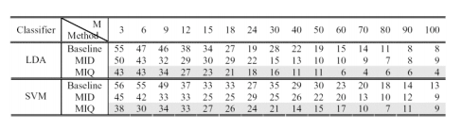
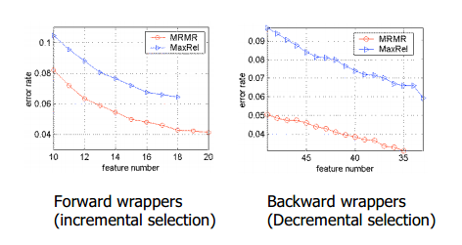
Statistics prove that MRMR Features Generalize Well on Unseen Data when coupled with a SVM Classifier.
From the figure, we can infer that SVM classifies data better than LDA.

Slide 16
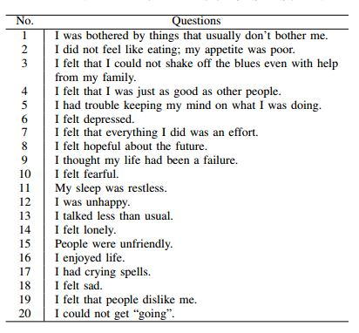
ACTUAL IMPLEMENTATION
Data Set

Slide 17
PSEUDOCODE
Initialise S = {Set of Attributes}
Initialise H= {Set of Targets}
Divide the sample space based on the Regions R={r1, r3.. rn}
For every region r_{i} do
Step 1 : For each attribute s∈S
For each Target concept h ∈ H
Calculate Mutual Relevance Information V_{s} =I (s, h)
End;
End;
Step 2 : For each pair of attributes s_{i ,} s_{j} ∈ S
Calculate Mutual Information W_{i,j}= I (s_{i ,} s_{j} )
End;
Step 3: Select set of attributes S’ = {Attributes with Max V_{s} and Min W_{i,j} }
Step 4: Measure the accuracy of S’ using Learning Classifier SVM
Step 5: Repeat Step1- Step4 until desired performance is achieved
Done

Slide 18
TOOLS USED:
Libsvm
LIBSVM is an integrated tool for support vector classification, regression as well as two variants: nu-SVM and one-class SVM.
SVM in MATLAB

Slide 19

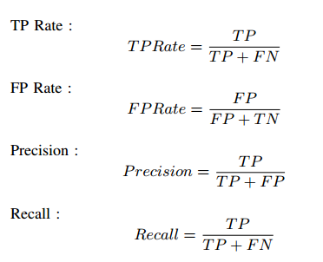
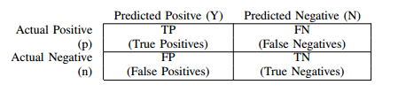
ASSESSMENT METRICS AND EXPECTED RESULTS

Slide 20


where β is a coefficient to adjust the relative importance of precision versus the recall
F-Measure is high when both the recall and precision are high. It indicates that the F-Measure is the measure of goodness of a learning algorithm on the interest class
The idea of G-Mean is to maximize the accuracy on each of two classes while these accuracies still balanced

Slide 21
EXPECTED RESULTS:
Methods | No of attributes | Overall Accuracy (%) | F- Measure of pos. class(%) | F-Measure of neg.class(%) | G-Mean(%)
Decision tree | 20 | 90.8824 | 63.7951 | 94.7811 | 76.287
Decision tree + MRMR | 12 | 93.3228 | 73.0581 | 96.1879 | 81.4454
MRMR + SVM | 10 | 94.0021 | 73.5212 | 96.5532 | 81.9931
The Highlighted row indicates the expected results of MRMR with SVM

Slide 22
CONCLUSIONS AND SCOPE FOR FUTURE WORK
We have hereby, developed a hybrid model for screening and predicting depression based on MRMR technique along with SVM
This technique can identify ten feature items that are sensitive for predicting depression
Then SVM is used to generate model and improve the prediction performances of both depression and non depression data sets
However, in this method, Diagnosis may fail to specify
whether the patient is actually suffering from mild or moderate or severe depression. Clustering techniques may be used to identify the same.

Slide 23
REFERENCES
[1] Boosting with Feature Selection Technique for Screening and Predicting Adolescents Depression by Putthiporn Thanathamathee School of informatics, Walailak University
[2] http://www.simafore.com/blog/bid/61099/Reasons-why-feature-selection-is-important-in-predictive-analytics
[3] http://www.public.asu.edu/~huanliu/papers/tkde05.pdf
[4]http://repository.asu.edu/attachments/110268/content/Alelyani_asu_0010E_12654.pdf
[5] http://www.mathworks.com/help/stats/support-vector-machines-svm.html
[6] http://www.csie.ntu.edu.tw/~cjlin/libsvm/oldfiles/index2.0.html
[7] http://www.kdnuggets.com/datasets/index.html
[8] https://archive.ics.uci.edu/ml/datasets.html

Slide 24
THANK YOU!!

